Slide 1
Session Plan - Day 2
Introduction to JSP
Basic tags in JSP
Lifecycle and lifecycle methods of JSP
Implicit objects in JSP
Tags in JSP
Directive Elements in JSP
Action Elements in JSP

Slide 2
JSP
A technology developed by Sun Microsystems for coding the presentation layer of an enterprise application
A JSP file is very similar to an HTML file, but has .jsp extension
Unlike HTML files, JSP files will contain some Java code also, within <% %> elements
The server associates the JSP with a URL
When the URL is invoked, the JSP is executed
Just like a ServletContainer is required for executing a Servlet, a JSP Container is required for executing a JSP
When a client requests for a JSP, the JSP container sends the HTML tags as-is to the browser
2

Slide 3
JSP
The code between <% and %> will be compiled, executed and the output will be sent to the browser
3
Notes:
At its most basic, a JSP is an HTML file containing special markup.
In fact, even a static HTML can be a JSP; simply change the file extension to .jsp.

Slide 4
Advantage of JSP over Servlet
Extension to Servlet
In addition to, we can use implicit objects, predefined tags, expression language and Custom tags in JSP, that makes JSP development easy.
Easy to maintain
JSP can be easily managed because we can easily separate our business logic with presentation logic. In servlet technology, we mix our business logic with the presentation logic.
Fast Development: No need to recompile and redeploy
If JSP page is modified, we don't need to recompile and redeploy the project. The servlet code needs to be updated and recompiled if we have to change the look and feel of the application.
Less code than Servlet
In JSP, we can use a lot of tags such as action tags, jstl, custom tags etc. that reduces the code. Moreover, we can use EL, implicit objects etc.
4
Notes:
At its most basic, a JSP is an HTML file containing special markup.
In fact, even a static HTML can be a JSP; simply change the file extension to .jsp.

Slide 5
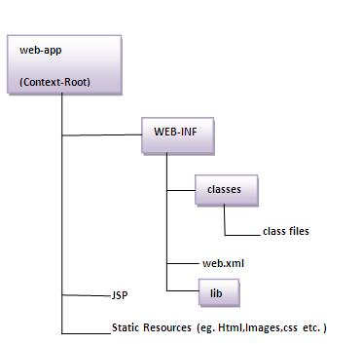
Directory structure of JSP

Slide 6
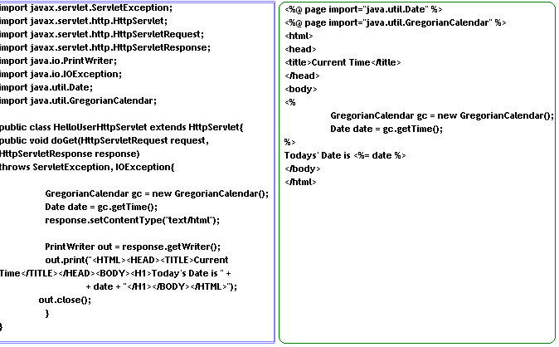
Servlets Vs JSP
Servlet
Bits of HTML embedded in Java code
Suitable for coding the business layer of an enterprise application
Created and maintained by Java programmers
JSP
Bits of Java code embedded in HTML
Suitable for coding the presentation layer of an enterprise application
Created and maintained by web designers
JSP
Servlet
6

Slide 7


JSP
Internally, the JSP Container converts the JSP into a Servlet when a user requests for a JSP for the first time
This Servlet would produce the output that the JSP file is supposed to produce
JSPContainer (Tomcat)
.jsp file
.java file
This is equivalent Servlet
7
Notes:
Traditional Application domain of the JSP is generating HTML content.
Increasingly important application domain for JSP technology is generating dynamic XML content using formats like XHTML, SVG and Open Office and in applications like content publishing, data representation and web services.

Slide 8
JSP Life Cycle
On first invocation, The Web server asks the JSP engine to check whether the JSP page has never been accessed before, or it has been modified since its last access. If this is the case the JSP engine will
1. Parse the JSP document to translate into a Servlet Java file
2. Compile the Servlet Java file into a class file
Then the Servlet container loads the Servlet class for execution and sends the results back to the client.
On subsequent invocations, the Web Container
Checks whether the JSP has changed since the equivalent Servlet has been created
If not, executes the Servlet again
If changed, recreates Servlet, compiles and executes it
8
Notes:
JSP Container manages - two phases of a JSP lifecycle.
In a translation phase, the container
-validates the syntactic correctness of the JSP pages and the tag files
-determines a JSP page implementation class that corresponds to the JSP page.
In the execution phase, the container
-manages one or more instances of this class in response to requests and other events.

Slide 9
Life Cycle Of JSP
The steps in the life cycle of a jsp page are:
Translation
Compilation
Loading
Instantiation
Initialization
Request Processing
Destruction
9

Slide 10
JSP API
The JSP API consists of two packages:
javax.servlet.jsp
javax.servlet.jsp.tagext
javax.servlet.jsp package
The javax.servlet.jsp package has two interfaces
JspPage
HttpJspPage
The classes are as follows:
JspWriter
PageContext
JspFactory
JspEngineInfo
JspException
JspError
10

Slide 11
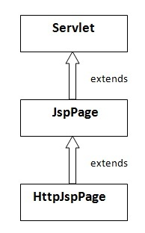
JspPage interface
According to the JSP specification, all the generated servlet classes must implement the JspPage interface. It extends the Servlet interface. It provides two life cycle methods.
JspPage interface
public void jspInit():
Public void jspDestroy();
HttpJspPage interface
Public void _jspService();
underscore _ signifies that you cannot override this method.

Slide 12
Tags in JSP
Tags in JSP can be categorized as
Comments <%-- This is a JSP Comment --%>
Scripting elements
Declarations <%! %>
Expressions <%= %>
Scriptlets <% %>
Directive elements
page
include
Taglib
Action elements
Template data
Any thing other than the above mentioned four categories fall under template data
This will include all HTML tags and text
<%@ directive attribute = “value” %>
<%@ page import = “java.util.ArrayList” %>
<%@ include file= “../header.html” %>
12
Notes:
Some of the important attributes of page directive elements are import, session, contentType, errorPage, isErrorPage, Extends, info
Action tags basically are used to control the flow between pages and to use Java Bean.
Some common standard actions tags are
<jsp:forward> - <jsp:forward page = “/common/TermsOfUse.jsp” />
<jsp:include> - <jsp:include page =“currentStock.jsp” />
<jsp:useBean> - <jsp:useBean id=“acct” class=“com.infy.enr.bean.AccountBean”/>
<jsp:setProperty> - <jsp:setProperty name=“accObj” property=“accountNo” value=“1001” />
<jsp:getProperty> - <jsp:getProperty name = “accObj" property = “accountNo" />
<jsp:param>

Slide 13
1. Comments
Just like any other HTML tag, standard HTML comment tag also can be used in JSP
<!-- This is a comment in HTML -->
The above comment tag will reach the browser
A JSP specific comment tag is written as follows, this tag will not reach the client
<%-- This is a JSP Comment --%>
13

Slide 14
2. Scripting Elements
Scripting elements are elements in the page that include the Java code
<% for(int i=0;i<10;i++){
out.print(“Welcome to JSP”);
} %>
JSP can contain 3 types of scripting elements
Declarations <%! %> (for classes)
Expressions <%= %>
Scriptlets <% %> (local to the service() )
14

Slide 15
2a. Scripting Elements - Declaration
Variables declared within <%! and %> will be a data member of the generated Servlet class and all the requests will use the same copy of this variable
<%!
double amount;
%>
Methods also can be declared using scripting elements
All methods NEEDS TO be declared within <%! and %> and they become a method of the generated Servlet
code written inside the jsp declaration tag is placed outside the service() method of auto generated servlet.
15
Notes:
Variable declare in declaration scriplets are global variable for the class i.e it define outside of any method

Slide 16
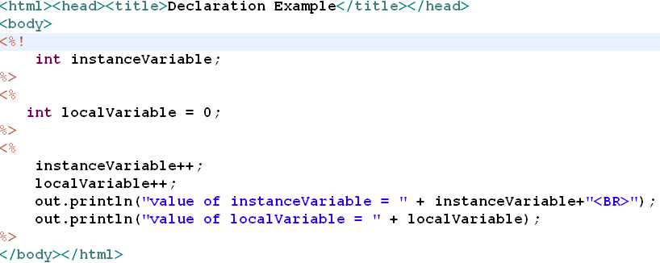
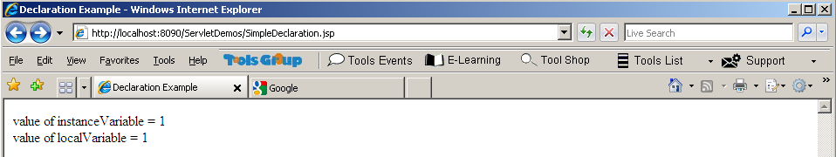
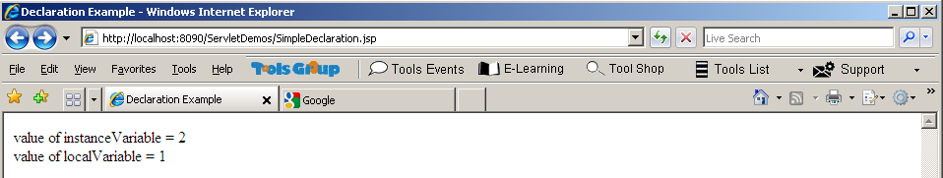
Example code : Variable Declarations
SimpleDeclaration.jsp
Execute it one more time…
Notes:
Deploy this JSP on to the Application Server and execute it and see the result

Slide 17
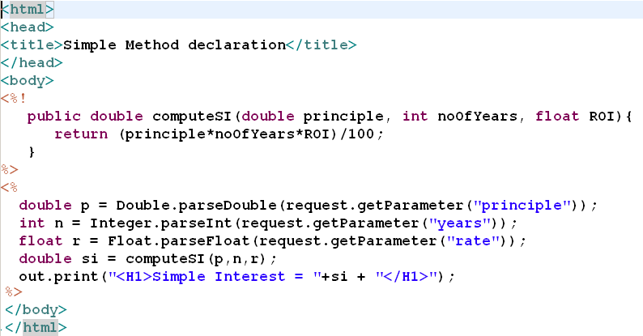
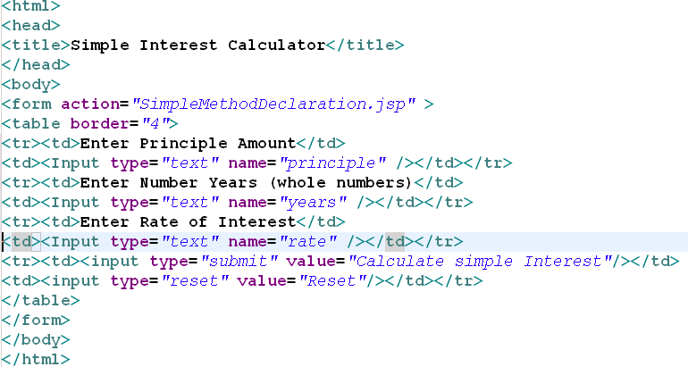
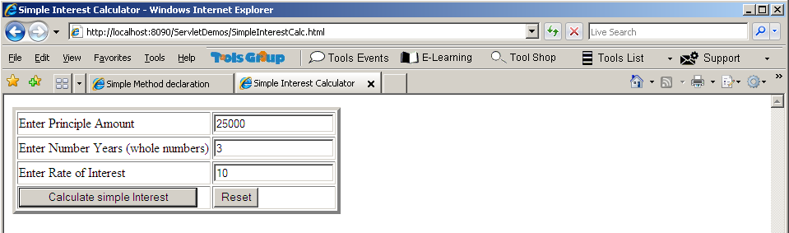
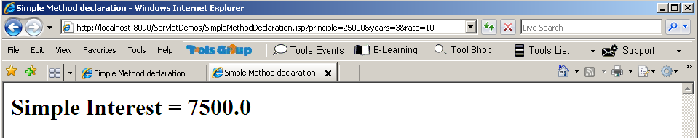
Example Code
SimpleInterestCalc.html
17

Slide 18
2b. Scripting Elements - Expressions
The value of an expression can be printed to the browser using the syntax <%= expression%>
In the previous example, we had below code:
<%
double si = compute(p,n,r);
out.print(“<H1>Simple Interest = “ + si + “<H1>”);
%>
Instead of writing this Java code to print the result on client browser, we can use expression elements as,
<%
double si = compute(p,n,r);
%>
<H1> Simple Interest = <%= si%> <H1>
Do not end your statement with semicolon in case of expression tag.
18

Slide 19
2c. Scripting Elements - Scriplet
Variables declared within <% and %> will be local to the service() method of the generated Servlet and each request will have a separate copy of this variable
<%
int data = 0;
%>
19
Notes:
Variable declare in <% %> scriplets are define in _jspService methods that why local to the servlet
The Java statements that appear between <% and %> are called scriptlet

Slide 20
Can you Answer these Questions?
Servlet
JSP will be converted to a during
phase
Translation
In which element can methods be declared in a JSP page?
Inside a JSP declaration element. Syntax <%! …. %>
The text written inside JSP expression element, <%= ..%> will be an argument to which method?
out.print() method

Slide 21
JSP Lifecycle methods
Lifecycle methods of JSP are:
jspInit
The code that should be executed only once when the JSP is invoked for the first time can be coded in a method jspInit()
The jspInit() method will be executed only once per JSP, not per request
This method contains code for initializing the JSP
Could be overridden in the JSP page using scripting element like declaration
_jspService
Can not be explicitly overridden
All scriptlets in that JSP get place in this method definition
The code that should be executed each time the JSP is requested has to go in this method.
Notes:
_jspService():
This method is not overridden explicitly, mean that it is not define in the parent interface but gets created in the converted servlet file.
All the scriptlets written in that JSP automatically goes in this method.

Slide 22
JSP Lifecycle methods
Lifecycle methods of JSP are:
jspDestroy
Could be overridden in the JSP page using scripting element
The code that should be executed only once when the JSP is unloaded from the memory can be coded in a method jspDestroy()
This method contains code to cleanup the resources used by the JSP
The signatures of the lifecycle methods:
public void jspInit();
public void _jspService(HtpServletRequest, HttpServletResponse) throws IOException, ServletException;
public jspDestroy();

Slide 23
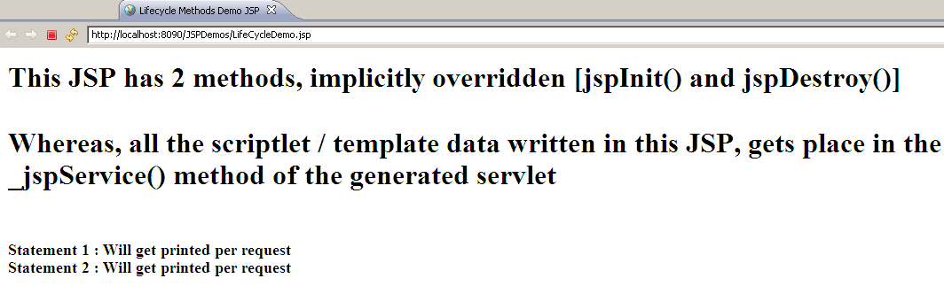
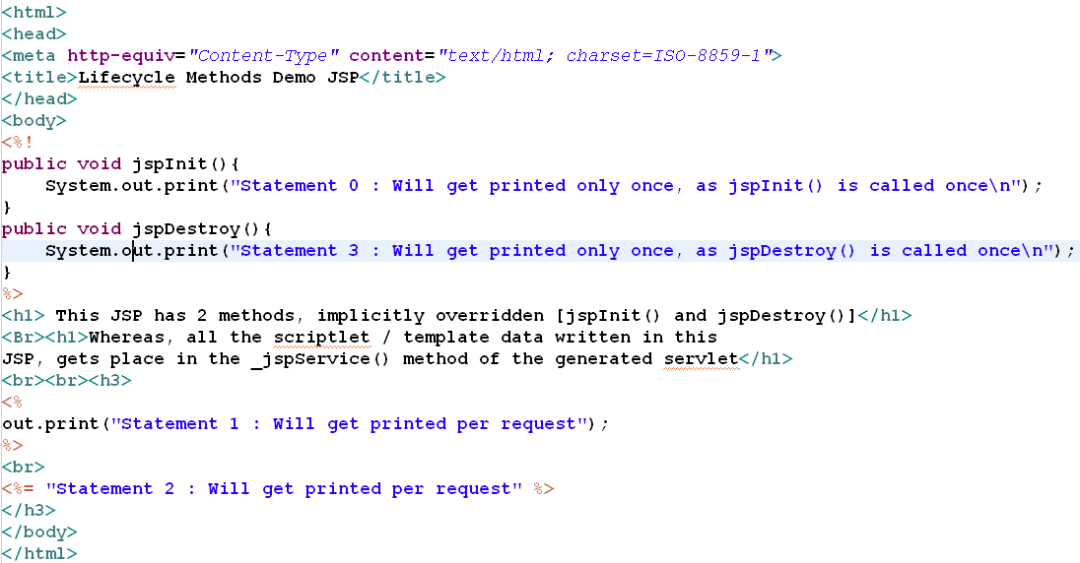
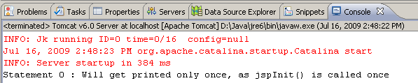
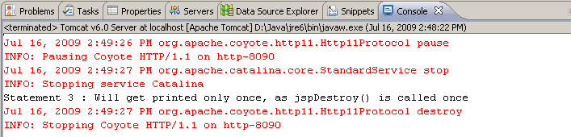
Example : JSP Lifecycle methods
Deploy and run the JSP in server
Stop the server and watch the console window
23
Notes:
Strictly For Your Reference:
The equivalent servlet code for the above JSP:
package org.apache.jsp;
import javax.servlet.*;
import javax.servlet.http.*;
import javax.servlet.jsp.*;
public final class LifeCycleDemo_jsp extends org.apache.jasper.runtime.HttpJspBase
implements org.apache.jasper.runtime.JspSourceDependent {
public void jspInit(){
System.out.print("Statement 0 : Will get printed only once, as jspInit() is called once\n");
}
public void jspDestroy(){
System.out.print("Statement 3 : Will get printed only once, as jspDestroy() is called once\n");
}
…
Continued in the next slide’s notes page

Slide 24
Intentionally left blank :refer notes page
Notes:
private static final JspFactory _jspxFactory = JspFactory.getDefaultFactory();
private static java.util.List _jspx_dependants;
private javax.el.ExpressionFactory _el_expressionfactory;
private org.apache.AnnotationProcessor _jsp_annotationprocessor;
public Object getDependants() {
return _jspx_dependants;
}
public void _jspInit() {
_el_expressionfactory = _jspxFactory.getJspApplicationContext(getServletConfig().getServletContext()).getExpressionFactory();
_jsp_annotationprocessor = (org.apache.AnnotationProcessor) getServletConfig().getServletContext().getAttribute(org.apache.AnnotationProcessor.class.getName());
}
public void _jspDestroy() {
}
public void _jspService(HttpServletRequest request, HttpServletResponse response)
throws java.io.IOException, ServletException {
PageContext pageContext = null;
HttpSession session = null;
ServletContext application = null;
ServletConfig config = null;
JspWriter out = null;
Object page = this;
JspWriter _jspx_out = null;
PageContext _jspx_page_context = null;
try {
response.setContentType("text/html; charset=ISO-8859-1");
pageContext = _jspxFactory.getPageContext(this, request, response,
null, true, 8192, true);
_jspx_page_context = pageContext;
application = pageContext.getServletContext();
config = pageContext.getServletConfig();
session = pageContext.getSession();
out = pageContext.getOut();
_jspx_out = out;
out.write("\r\n");
out.write("<!DOCTYPE html PUBLIC \"-//W3C//DTD HTML 4.01 Transitional//EN\" \"http://www.w3.org/TR/html4/loose.dtd\">\r\n");
out.write("<html>\r\n");
out.write("<head>\r\n");
out.write("<meta http-equiv=\"Content-Type\" content=\"text/html; charset=ISO-8859-1\">\r\n");
out.write("<title>Lifecycle Methods Demo JSP</title>\r\n");
out.write("</head>\r\n");
out.write("<body>\r\n");
out.write("\r\n");
out.write("<h1> This JSP has 2 methods, implicitly overridden [jspInit() and jspDestroy()]</h1>\r\n");
out.write("<Br><h1>Whereas, all the scriptlet / template data written in this\r\n");
out.write("JSP, gets place in the _jspService() method of the generated servlet</h1>\r\n");
out.write("<br><br><h3>\r\n");
out.print("Statement 1 : Will get printed per request");
out.write("\r\n");
out.write("<br>\r\n");
out.print( "Statement 2 : Will get printed per request" );
out.write("\r\n");
out.write("</h3>\r\n");
out.write("</body>\r\n");
out.write("</html>");
} catch (Throwable t) {
if (!(t instanceof SkipPageException)){
out = _jspx_out;
if (out != null && out.getBufferSize() != 0)
try { out.clearBuffer(); } catch (java.io.IOException e) {}
if (_jspx_page_context != null) _jspx_page_context.handlePageException(t);
}
} finally {
_jspxFactory.releasePageContext(_jspx_page_context);
}
}
}

Slide 25
Implicit Objects:
Can be used within the Java code (scriptlets) in a JSP, without ever having to declare them, hence the name, implicit objects
They are defined either in Servlet API / in JSP API
IMPLICIT OBJECTS → Classes defined in API
out javax.servlet.jsp.JspWriter
request javax.servlet.http.HttpServletRequest
response javax.servlet.http.HttpServletResponse
session javax.servlet.http.HttpSession
application javax.servlet.ServletContext – share same info across pages
config javax.servlet.ServletConfig- pass initial data to jsp pages
exception * javax.servlet.jsp.JspException
Page processes the current request.
(* Only available in error pages)
They are made available by the Web Container, in _jspService() method
25
Notes:
These objects are parsed by JSP engine and inserted into the generated servlets
application: This object is available at the widest context level, that allows to share the same information between the JSP page’s servlet and any Web components contained in the same application.
config: Config object allows to pass the initialization data to a JSP page's servlet.
exception: Exception object allows the exception data to be accessed only by designated JSP "error pages."
out: This object allows us to access the servlet's output stream.
page: This object is an instance of the JSP page's servlet class that processes the current request.
pageContext: PageContext is the context for the JSP page itself that provides a single API to manage the various scoped attributes. This API is extensively used if we are implementing JSP custom tag handlers.
request: Request object is used to access the HTTP request data, and also provides a context to associate the request-specific data.
response: This object allows direct access to the HTTPServletResponse class object.
session: Perhaps it is the most commonly used object to manage the state contexts.

Slide 26
Implicit Objects - out
The implicit object out is a Writer with which the web developer can write to the client
The print() method of out is used to write data to the browser
out.print(“Hello ” + userName);
out.println(“The rate of interest is ” + rateOfInt);
26
Notes:
out implicit object is a reference to the JspWriter object passed to the _jspService() method by the Container

Slide 27
Implicit Objects - request
The implicit object request is used by JSP to get all information about the HTTP request
The getParameter() method of the request object can be used to retrieve the parameters the user has passed to the JSP using HTML Form
request implicit object is a reference to the HTTPServletRequest object passed to the _jspService() method by the Container.
String userName = request.getParameter(“UserName”);
Here, the assumption is there is HTML form input element, named UserName.
27
Notes:
If parameter name is mis-spelled or parameter which is written inside this method is not present, then this method returns null.
This condition is used to check “mandatory fields” in server-side validation.
Request.getParameter() always returns the string value of the parameter

Slide 28
Implicit Objects - response
The implicit object response is used for manipulating the HTTP response to the client
For example, the method sendError() will send an error status code to the client
response implicit object is a reference to the HTTPServletResponse object passed to the _jspService() method by the Container.
response.sendError(404);
response.setContentType(“application/vnd.ms-excel”);
28

Slide 29
Session Tracking
HTTP is a stateless protocol - subsequent requests will not tell the server which client is making these requests
A session starts, whenever a client accesses any one page in the application
A session will end,
if the client is not responding for a predefined period of time
By calling appropriate methods when the client logs out
After the end of a session, if the client accesses a page in the application again, it will be considered as a new session
Since the protocol by itself is not tracking the session, the programmer has to take care of tracking the session
29
Notes:
In some cases, a JSP may want to know the specific client that asks for a service
Online banking service, would like to know about the requests made by the specific client, until she logs out
From the time of accessing any one page in the application, till logging out, we may want to know the requests made by a client
This is called Session Tracking

Slide 30
Techniques to do Session Tracking
Use cookies - HTTP cookies to store information about a shopping session, and each subsequent connection can look up the current session and then extract information about that session
Use URL rewriting - the client appends some extra data on the end of each URL that identifies the session, and the server associates that identifier with data it has stored about that session
Use hidden form fields –
<INPUT TYPE="HIDDEN" NAME="session" VALUE="...">
Use Session Tracking API (HttpSession)
30
Notes:
HTTP is a "stateless" protocol: each time a client retrieves a Web page, it opens a separate connection to the Web server.
The server does not automatically maintain contextual information about a client, HTTP connections and keep a socket open for multiple client requests that occur close together in time, there is no built-in support for maintaining contextual information. This lack of context causes a number of difficulties. For example, when clients at an online store add an item to their shopping carts, how does the server know what's already in the carts? Similarly, when clients decide to proceed to checkout, how can the server determine which previously created shopping carts are theirs?
If you want to perform session tracking yourself then,
There are three typical solutions to this problem: cookies, URL rewriting, and hidden form fields.
Cookies: You can use HTTP cookies to store information about a shopping session, and each subsequent connection can look up the current session and then extract information about that session from some location on the server machine
URL Rewriting: With this approach, the client appends some extra data on the end of each URL that identifies the session,
and the server associates that identifier with data it has stored about that session
Hidden Form Fields: HTML forms can have an entry that looks like the following
<INPUT TYPE="HIDDEN" NAME="session" VALUE="...">
This entry means that, when the form is submitted, the specified name and value are included in the GET or POST data. This hidden field can be used to store information about the session but has the major disadvantage that it only works if every page is dynamically generated by a form submission. Thus, hidden form fields cannot support general session tracking, only tracking within a specific series of operations.

Slide 31
Implicit Objects - session
The implicit object session helps the JSP to communicate with the Web Server for session tracking
The method session.getId() returns a unique String that can be used to identify a session
The data to be shared by all the JSPs invoked in the same session can be stored as an attribute of the session object as session variables
31
Notes:
Session Tracking in Servlets
Servlets provide an outstanding technical solution: the HttpSession API. This high-level interface is built on top of cookies or URL rewriting. All servers are required to support session tracking with cookies, and many have a setting that lets you globally switch to URL rewriting. In fact, some servers use cookies if the browser supports them but automatically revert to URL rewriting when cookies are unsupported or explicitly disabled.
So, object of this class is implicitly available in JSP page by default, unless and until you choose not to have it!

Slide 32
Session attributes
The methods used for setting and getting a session attribute are follows
void setAttribute(String name, Object value)
Object getAttribute(String name)
Example scenario:
User logs in to the application through LoginForm.html and eventually Login.jsp shows user her list of accounts. If user clicks on a particular account, user is shown with that account details in AccountSummary.jsp.
(Note: Collection classes are used to store the data)

Slide 33
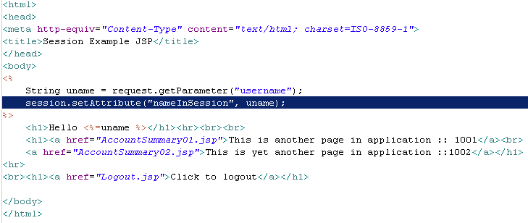
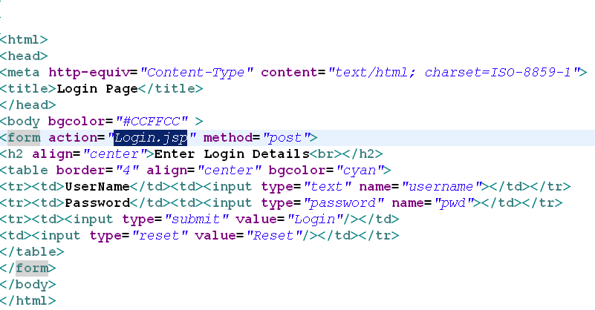
Example –session tracking
Login.jsp
loginForm.html
33
Notes:
Code for loginForm.html
<html><head><meta http-equiv="Content-Type" content="text/html; charset=ISO-8859-1"><title>Login Page</title></head>
<body bgcolor="#CCFFCC" >
<form action="Login.jsp" method="post">
<h2 align="center">Enter Login Details<br></h2>
<table border="4" align="center" bgcolor="cyan">
<tr><td>UserName</td><td><input type="text" name="username"></td></tr>
<tr><td>Password</td><td><input type="password" name="pwd"></td></tr>
<tr><td><input type="submit" value="Login"/></td>
<td><input type="reset" value="Reset"/></td></tr>
</table></form></body></html>
Login.jsp code:
<html><head><meta http-equiv="Content-Type" content="text/html; charset=ISO-8859-1“><title>Session Example JSP</title></head><body>
<%
String uname = request.getParameter("username");
session.setAttribute("nameInSession", uname);
%>
<h1>Hello <%=uname %></h1><hr><br><br>
<h1><a href="AccountSummary01.jsp">This is another page in application :: 1001</a><br>
<a href="AccountSummary02.jsp">This is yet another page in application ::1002</a></h1>
<hr>
<br><h1><a href="Logout.jsp">Click to logout</a></h1>
</body></html>

Slide 34
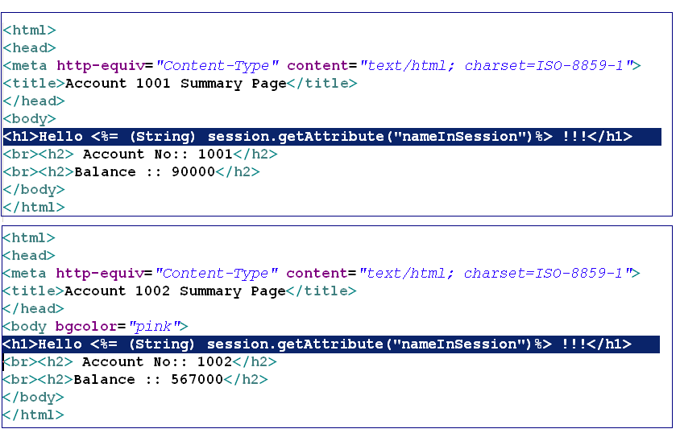
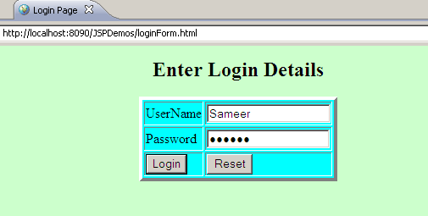
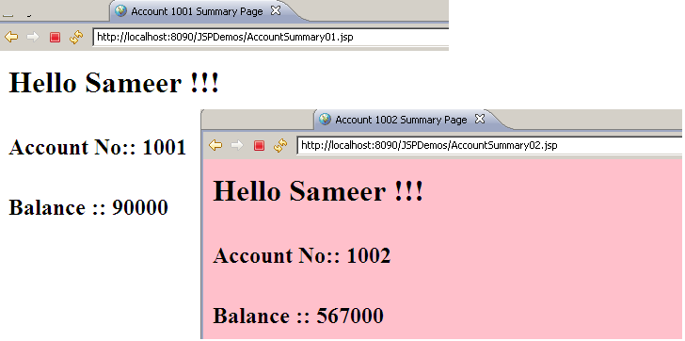
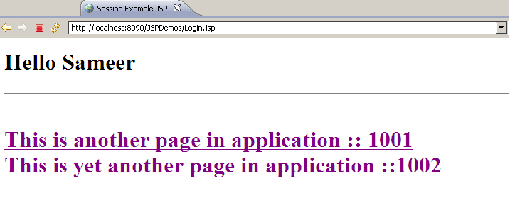
session tracking - Execution
AccountSummary01.jsp
In both JSP, we are retrieving the username, by which user logged in, using the session attribute
AccountSummary02.jsp
In this JSP we are setting session attribute, so that any other JSP in the same application can use that value for the current session
34
Notes:
Code for AccountSummary pages:
<html>
<head>
<meta http-equiv="Content-Type" content="text/html; charset=ISO-8859-1">
<title>Account 1002 Summary Page</title>
</head>
<body bgcolor="pink">
<h1>Hello <%= (String) session.getAttribute("nameInSession")%> !!!</h1>
<br><h2> Account No:: 1002</h2>
<br><h2>Balance :: 567000</h2>
<hr>
<br><h1><a href="Logout.jsp">Click to logout</a></h1>
</body>
</html>

Slide 35
Implicit Objects - session
The call to the method session.invalidate() will kill a session
Any request made by the client after this method call, will be treated as a new session
Typically this code is executed when the user logs out of the application
35
Notes:
Some useful methods from HTTPSession apart from invalidate() are as follows…
getCreationTime() -> to find out how old the session is. It returns the time the session was first created.
getLastAccessedTime() -> to find out when a client last accessed this session. It returns the last time the container got a request with this session ID (in milliseconds).
setMaxInactiveInterval() -> To cause a session to be destroyed after a certain amount of time has passed without the client made any requests for this session. It specifies maximum time, in seconds, that you want to allow between client requests for this session.
getMaxInactiveInterval() -> To find out how long this session can be inactive and still alive. It returns the maximum time, in seconds, that is allowed between client requests for this session.

Slide 36
After invalidating a session …
After session is invalidated, if you try to get/set the session attributes, in the same page, it gives IllegalStateException
However, calling below methods after invalidating session, will not throw any exception
isNew()
getId()
getMaxInactiveInterval()
setMaxInactiveInterval()
Rest all other methods of HttpSession will throw IllegalStateException, if invoked on invalidated session
36
Notes:
Self study slide: intentionally hidden

Slide 37
Implicit Object - application
The implicit object application can be used to share data with all the JSPs in the same application
Same set of methods are used to set application- scoped attributes:
void setAttribute(String name, Object value)
Object getAttribute(String name)
Useful to share data between the pages of same application
37
Notes:
The application object is of type javax.servlet.ServletContext

Slide 38
Let us revisit implicit Objects
User submitted form data can be obtained in JSP using
request implicit object i.e. request.getParameter(“..”);
Excel file needs to be sent as response. How?
Using response.setContentType(“application/vnd.ms-excel”);
How will the server uniquely identify each client?
Server generates a session id for each client on the first request, can be obtained using session.getId()
exception
………....... implicit object is used to handle runtime exceptions

Slide 39
JSP tag: Directive Elements
jsp directives are messages that tells the web container how to translate a JSP page into the corresponding servlet.
JSP can contain three types of directives
page
include
Taglib
Syntax
<%@ directive attribute="value" %>
39
Notes:
Directive elements provide information to the JSP container about the page

Slide 40
page Directive
It defines attributes that apply to an entire JSP page
The page directive has the following form
Some of the important attributes are
import
session
contentType
errorPage
isErrorPage
Extends
info
<%@ page attributes %>
40

Slide 41
page Directive – import attribute
Just like a normal Java Program, the Java code embedded in a JSP page should import all the classes and interfaces used in the code
This is the only page directive which may appear anywhere in JSP and multiple times
Examples
<%@ page import = “java.util.ArrayList” %>
<%@ page import = “com.infy.banking.Account” %>
<%@ page import = “java.io.*, java.net.Socket” %>
It is a Bad Programming Practice!!!
41

Slide 42
page Directive – session attribute
The implicit object, session, is available only if this attribute’s value is set to true (default value)
The value of this attribute can be set to false if the Servlet is not tracking the session i.e.
Setting session = “false” prevents the creation of the implicit object “session”
Example:
<%@ page session = “false” %>
42
Notes:
By default, the generated Servlet creates an object called session

Slide 43
page Directive – contentType attribute
The browser can accept many file types - HTML, Plain Text, JPG Images, XML etc
The default value is “text/html”
(can be any valid MIME type)
Examples
<%@ page contentType = “text/plain” %>
<%@ page contentType = “text/xml” %>
<%@ page contentType = “application/vnd.ms.excel” %>
<%@ page contentType = “image/gif” %>
43
Notes:
To ensure proper display of the file, the file type has to be specified using a standard called MIME or multipurpose internet mail extension
Multipurpose Internet Mail Extension(MIME)

Slide 44
The page Directive – errorPage attribute
The errorPage attribute is used to define the error page, if exception occurs in the current page, it will be redirected to the error page.
The exception object will be set as an attribute in the request object so that the error JSP page can also access the exception object
Example
<%@ page errorPage = “error.jsp” %>
44

Slide 45
The page Directive – isErrorPage attribute
Error pages like error.jsp in the previous example should contain this tag
The presence of this tag creates a new Throwable object called exception in the generated Servlet
So, exception is an implicit object that we can use only in error pages
Example- In the error.jsp, you need to write the following line…
<%@ page isErrorPage = “true” %>
45
Notes:
The exception generated in the original page and passed as an attribute of the request will be assigned to this.

Slide 46
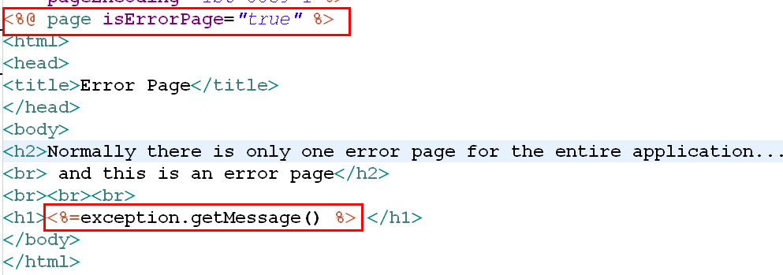
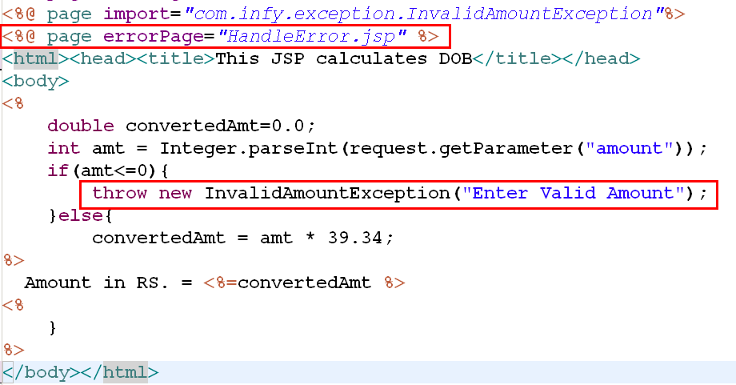
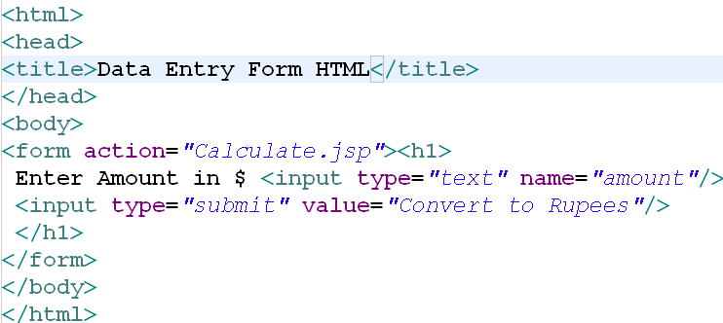
page Directive - errorPage and isErrorPage
HandleError.jsp
Calculate.jsp
46

Slide 47
The include Directive
The include directive can be used to include the contents of some other file in a JSP. It increase the code usability
<%@ include file = "../Header.html" %>
The contents of the included file will be pasted as a part of the JSP
The contents can be static (HTML Page) or dynamic (Another JSP)
The contents of a page can thus be separated into more manageable elements.
It increase the size of jsp at runtime
47

Slide 48
The include Directive
The include directive acts at compile time and any change in the included file will NOT be reflected in the including file
Many dynamic pages contain common static parts in them, mostly header and footer
The common static parts can be stored as HTML files that can be included in a JSP
48
Notes:
In the above example, the tags in the static pages Header.html and Footer.html will not change with each request. A runtime inclusion will be an overhead in this case. The include directive provides a compile time inclusion and hence there is no overhead for each request

Slide 49
Directive elements
Legal attributes of page directive are
include
session
import
errorPage
file
Set session attribute as false for doing session tracking.
TRUE
FALSE
Exception handling in JSP
<%@ page isErrorPage="errorPage.jsp" %>
<%@ page isErrorPage=“true" %>
<%@ page errorPage=“true" %>
<%@ page errorPage=“errorPage.jsp" %>

Slide 50
JSP Taglib directive
JSP taglib directive is used to define a tag library that defines many tags. We use the TLD (Tag Library Descriptor) file to define the tags. In the custom tag section we will use this tag so it will be better to learn it in custom tag.
Notes:
<html>
<body>
<%@ taglib uri="http://www.javatpoint.com/tags" prefix="mytag" %>
<mytag:currentDate/>
</body>
</html>

Slide 51
Action Elements
Action elements are tags that affect the runtime behavior of a JSP
The action tags basically are used to control the flow between pages and to use Java Bean.
Action elements are also known as Standard Actions
Some common standard actions are
<jsp:forward>
<jsp:include>
<jsp:useBean>
<jsp:setProperty>
<jsp:getProperty>
<jsp:param>
51

Slide 52
Forwarding a Request
Forwarding is used when two or more JSPs share some work
One JSP can do some processing and forward the request to another JSP for further processing
This enables modular design
When a JSP forwards the request to another JSP, the request and response objects are shared
52
Notes:
Normally client would NOT come to know about the forwarding of the request.
If some data is to be shared between these JSPs, it can be shared as a request attribute
These belong to request object:
void setAttribute (String name, Object value)
Object getAttribute (String name)

Slide 53
Standard Actions - jsp:forward
The <jsp:forward> tag is used to forward a request to another page
The control will be given to the target page
We can pass parameters to the forwarded page using <jsp:param> tag
<jsp:forward page = “url” />
<jsp:forward page = “/common/TermsOfUse.jsp” />
<jsp:forward page = “<%= nextPage %>” />
<jsp:forward page = “url”>
<jsp:param name = “name” value = “value” />
</jsp:forward>
53
Notes:
Consider, nextPage is a String variable, and will have some different values at different point of time!
Like, “Home.jsp” or “AddAccount.jsp” or “ModifyCustomerForm.html” and so on…

Slide 54
Standard Actions - jsp:forward
54

Slide 55
Standard Actions - jsp:include
The <jsp:include> tag is used to include the contents of another file in a JSP
The contents can be static (HTML Page) or dynamic (Another JSP)
The contents of a page can thus be separated into more manageable elements
Examples…
<jsp:include page = “url” />
<jsp:include page =“currentStock.jsp” />
<jsp:include page =“calculateBonus.jsp” >
<jsp:param name = “age”
value = “<%= request.getParameter(“Age”)%>” />
<jsp:param name = “incentive” value = “76.3” />
<jsp:param name = “band” value = “<%= varBand%>”>
</jsp:include>
55

Slide 56
Standard Actions - jsp:include
The inclusion of the page happens at runtime
So, if the included file is modified, the next request will receive the modified content
Just as in the case of request forwarding, the request and response objects are shared here and data can be shared using request attributes
56

Slide 57
Standard Actions - jsp:useBean, jsp:setProperty, jsp:getProperty
Minimizing Java code in a JSP will enable even a web designer to maintain it
To separate presentation from code, we can encapsulate the logic in a JavaBean
JSP can instantiate a JavaBean using the <jsp:useBean> tag, set the bean properties using the <jsp:setProperty> tag and get the bean properties using the <jsp:getProperty> tag
57

Slide 58
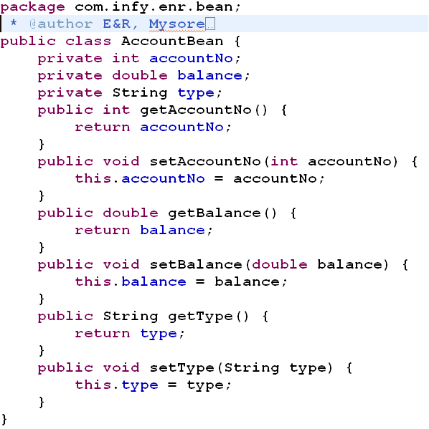
Standard Actions - jsp:useBean
The <jsp:useBean> tag for instantiating the WishBean is as follows
The above tag is equivalent to the following Java code
<jsp:useBean id = “accObj" class = “com.infy.enr.AccountBean” />
com.infy.enr.AccountBean accObj = new com.infy.enr.AccountBean();
58
Notes:
<jsp:useBean id=“acct” class=“com.infy.enr.bean.AccountBean”/>

Slide 59
Standard Actions - jsp:useBean
The important attributes of <jsp:useBean> tag are
id
class
scope
The id attribute
Specifies the name of the Bean object
Ex: accObj
The class attribute
Specifies the fully qualified name of the Bean class
Ex: com.infy.enr.bean.AccountBean
Package Name
Class Name
59

Slide 60
Standard Actions - jsp:useBean
The scope attribute - specifies the scope of the Bean object as page, request, session or application
The page scope (default)
Available only for this request and only in this page
The request scope
Available only for this request
Available to other forwarded and included JSPs
The session scope
Available to the current session
The application scope
Available to any JSP in the same application
60

Slide 61
Standard Actions - jsp:setProperty
The <jsp:setProperty> tag can be used to set the Bean properties
The <jsp:setProperty> tag to set the bean property wish of WishBean to the value Welcome is as follows
The above tag is equivalent to the following Java code
<jsp:setProperty name=“accObj” property=“type”
value=“savings” />
accObj.setType(“savings”);
61

Slide 62
Standard Actions - jsp:setProperty
The attributes are
name - Specifies the id of the Bean object
property
Specifies the name of the bean property that is to be set
If this attribute is *, all the request parameters will be assigned to bean properties based on matching name
param
Specifies the name of the request parameter whose value is to be put in to the bean property
<jsp:setProperty name=“accObj” property=“*” />
<jsp:setProperty name=“accObj” property=“type” param=“accountType” />
62
Notes:
property:
If this attribute is *, all the request parameters will be assigned to bean properties based on matching name.
If the names of some of the request parameters are not matching, then programmer has to explicitly, set the properties, using jsp:setProperty –param tags for those parameters.
param:
If value for param attribute is not specified, the value of the request parameter whose name is same as that of the bean property will be assigned to the bean property

Slide 63
Standard Actions - jsp:setProperty
value
Specifies the value to be assigned to the bean property
A tag cannot have both param and value attributes together
<% double bal=90000.88; %>
<jsp:setProperty name=“accObj” property=“accountNo” value=“1001” />
<jsp:setProperty name=“accObj” property=“balance”
value=“<%=bal%>”/>
63
Notes:
myName in the example is a String object; as in
String myName = “Jane”;
If the data types of the bean properties are other than, primitive data types, wrapper classes and/or String then, you have to use, jsp:setProperty with value attribute. Programmer has to do explicit type conversion.

Slide 64
Standard Actions - jsp:getProperty
The <jsp:getProperty> tag can be used to get the value of a bean property
The <jsp:getProperty> can be used to get the property wish of the WishBean as follows
The above statement will return us a String literal, and print on the client
1001
The above tag is equivalent to the following Java code
<jsp:getProperty name = “accObj" property = “accountNo" />
out.print(accObj.getAccountNo());
64
Notes:
In order to print all the properties of the bean, one CAN NOT use wild card (*) character in property attribute.

Slide 65
Standard Actions - jsp:getProperty
Retrieves the value of the property and prints on the output stream
The attributes are
name
property
The name attribute
Specifies the id of the Bean object
The property attribute
Specifies the name of the bean property to get
65

Slide 66
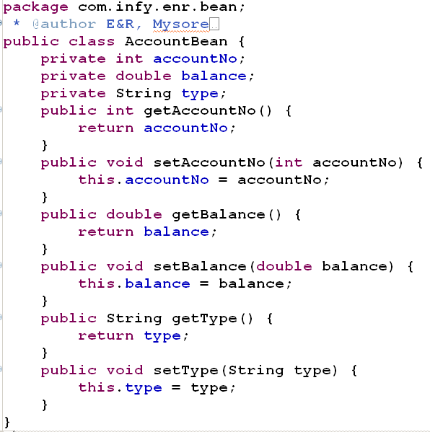
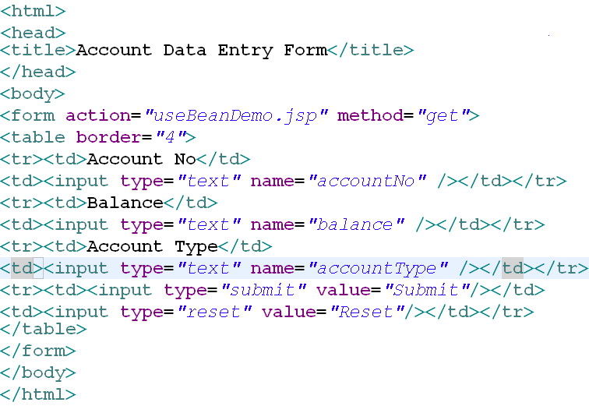
Standard Actions - jsp:useBean, jsp:setProperty, jsp:getProperty
66

Slide 67
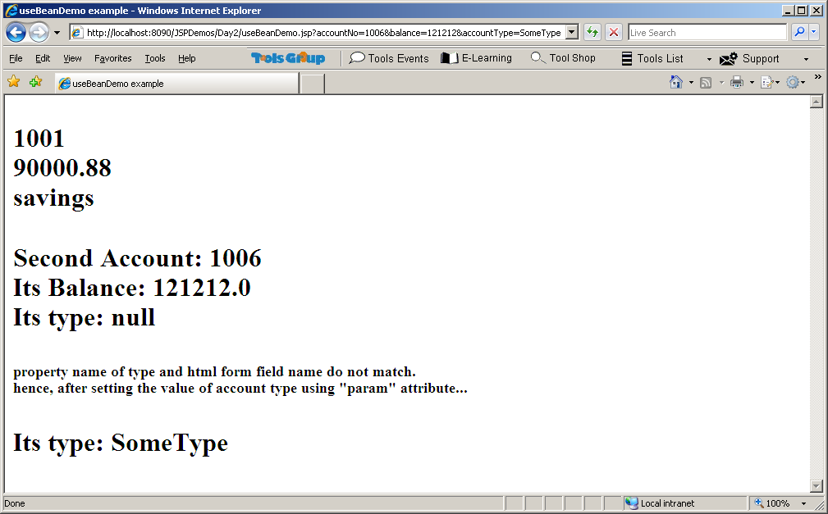
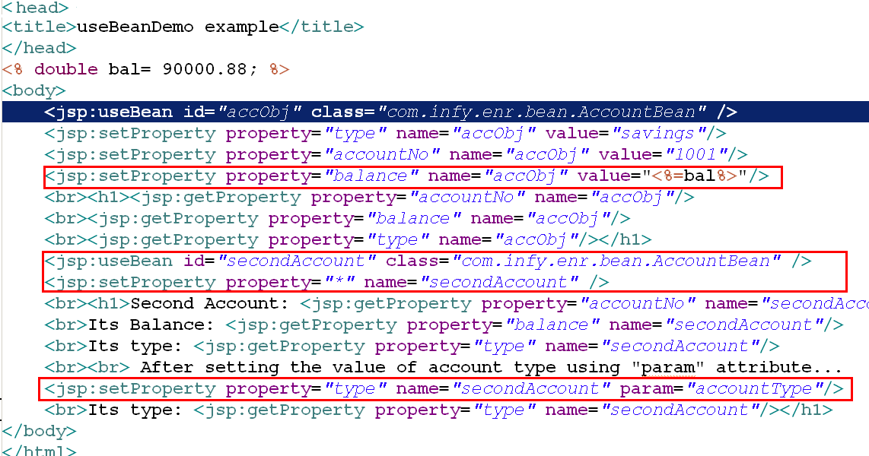
Standard Actions - jsp:useBean, jsp:setProperty, jsp:getProperty
67

Slide 68
Action elements
How do we include static files within JSP page
Using <jsp:include> or <%@ page include >
But using include directive is better
How to pass information from JSP to included/forwarded JSP
Using <jsp:param>
Bean objects can be created in JSP using
Using <jsp:useBean>
Bean object created using <jsp:useBean id=“account” class=“com.infy.enr.Account”> is stored in scope
Here no scope is specified so it will be in default scope i.e. page

Slide 69
Summary
JSP help us to code server side presentation logic
JSP has various tags which helps programmers to create, maintain it easily for dynamic content generation
JSP container (web container) converts JSP into Servlet Java code, which in turn is compiled into Servlet class.
Template data is sent as it is, where as scriptlets and JSP tags are compiled and executed
Directive elements are directions to Container about JSP, where as Action elements change runtime behavior of the JSP
69

